Slide 1
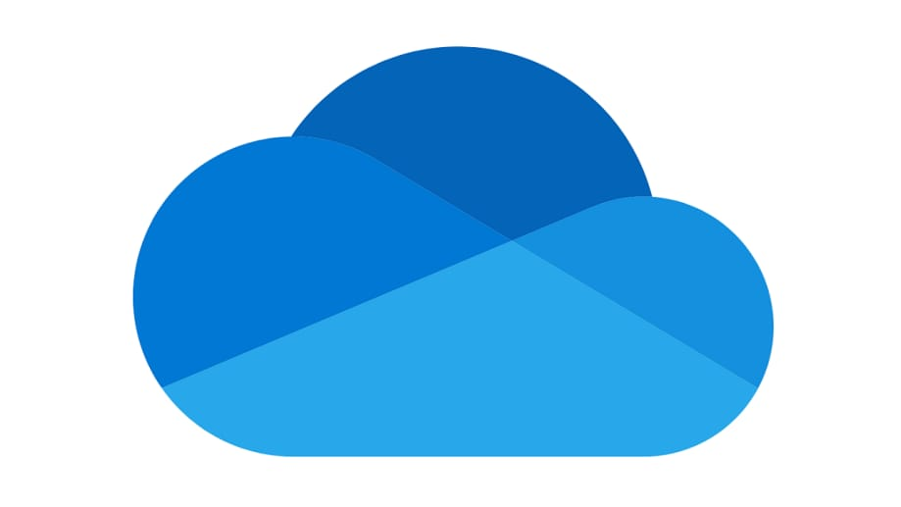

Cloud Storage and Collaboration Tools
M.Arif
25F-CY-094
Notes:
Are your classroom colors different than what you see in this template? That’s OK! Click on Design -> Variants (the down arrow) -> Pick the color scheme that works for you!
Feel free to change any “You will…” and “I will…” statements to ensure they align with your classroom procedures and rules!

Slide 2
What is Cloud Storage?
Cloud storage is a service that allows users to store data on the internet instead of local devices.
Data is saved on remote servers managed by service providers.
It can be accessed anytime using any device with internet.

Slide 3
How Cloud Storage Works
Users upload data through the internet.
The data is stored securely on cloud servers.
Users can log in to access, download, edit or share the data whenever needed.

Slide 4
Uses of Cloud Storage
Storing photos, videos, documents
Creating online backups
Syncing data across different devices
Sharing files with others
Accessing study or work materials online

Slide 5
Benefits of Cloud Storage
Access data from anywhere
Expandable storage
Automatic backup and recovery
Easy file sharing
Saves cost (no need for physical storage devices)

Slide 6
Examples of Cloud Storage
Google Drive
Dropbox
Microsoft OneDrive
Apple iCloud
Mega

Slide 7
What are Collaboration Tools?
Digital tools that help people work together online.
Allow real-time communication, sharing, and editing.
Useful for teams, students, and remote workers.

Slide 8
Uses of Collaboration Tools
Online meetings and video conferencing
Group projects and assignments
Team messaging and chats
Real-time editing of documents and spreadsheets
Managing tasks and projects

Slide 9
Benefits of Collaboration Tools
Improved teamwork and productivity
Saves time and reduces effort
Better communication
Helps remote work
Reduces errors and miscommunication

Slide 10
Examples of Collaboration Tools
Google Workspace
Microsoft Teams
Zoom
Slack
Trello

Slide 11
Thank You

